Slide 1
Boltzmann equation in CMB calculation
徐睿
清华大学 天文系
2023/11/15
DoA Cosmology Club

Slide 2
Outline
Homogenous and isotropic cosmology
CMB anisotropy

Slide 3
Outline
Homogenous and isotropic cosmology
CMB anisotropy

Slide 4
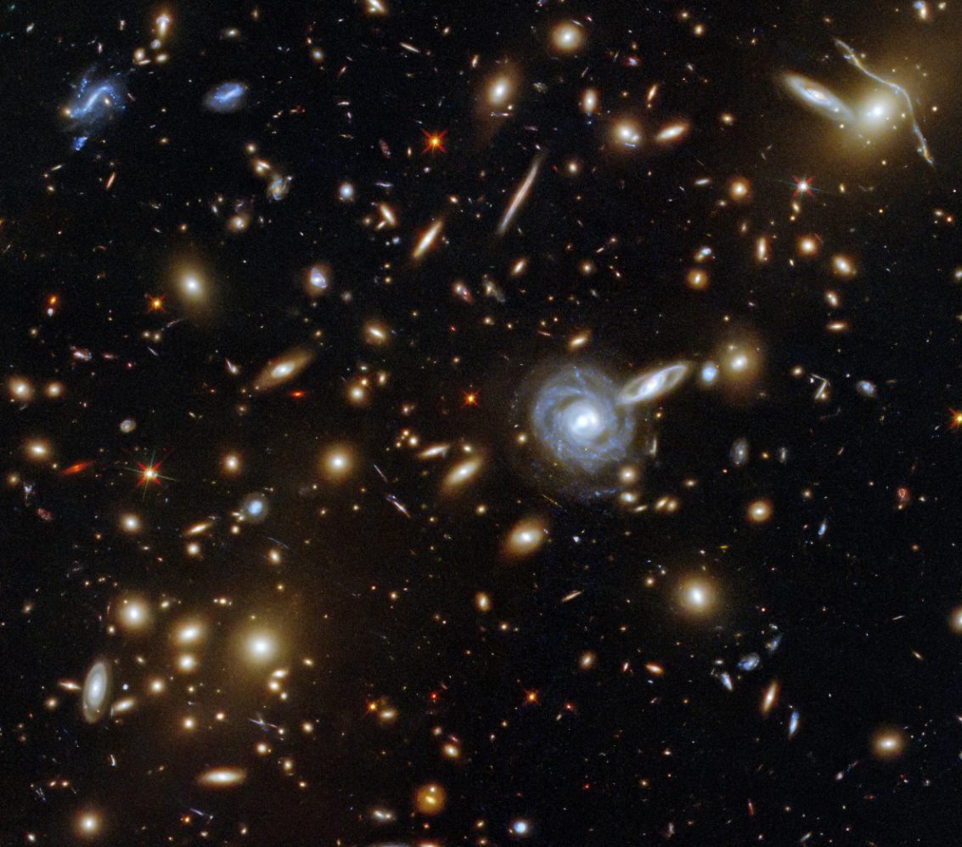
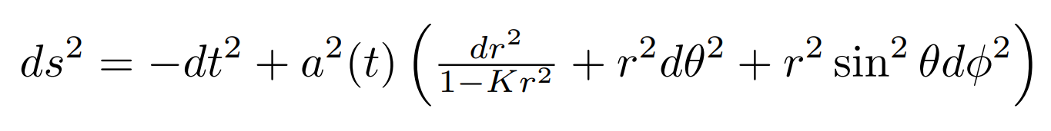
FLRW metric
Cosmological principle:
On the large scale, spacetime of the universe is
homogeneous
isotropy
Friedmann-Lemaitre-Robertson-Walker metric

Slide 5
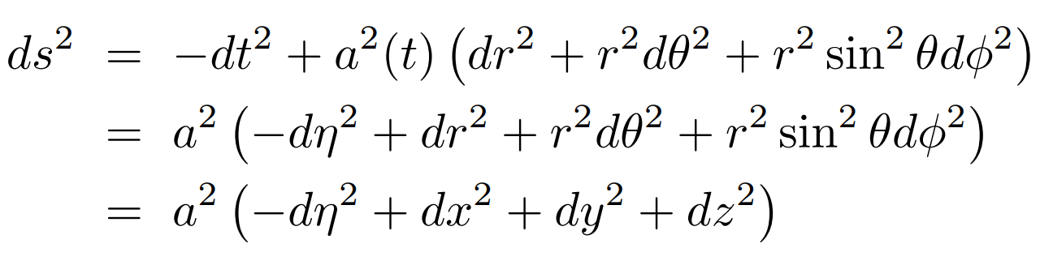
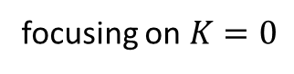
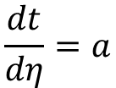
FLRW metric
Cosmological principle:
On the large scale, spacetime of the universe is
homogeneous
isotropy
focusing on $K=0$
$$\frac{dt}{dη}=a$$

Slide 6
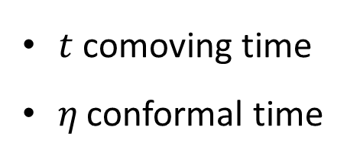
FLRW metric
conformally flat
$t$ comoving time
𝜂 conformal time

Slide 7
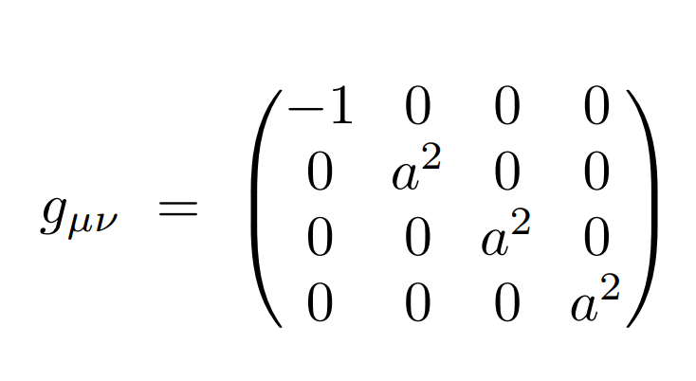
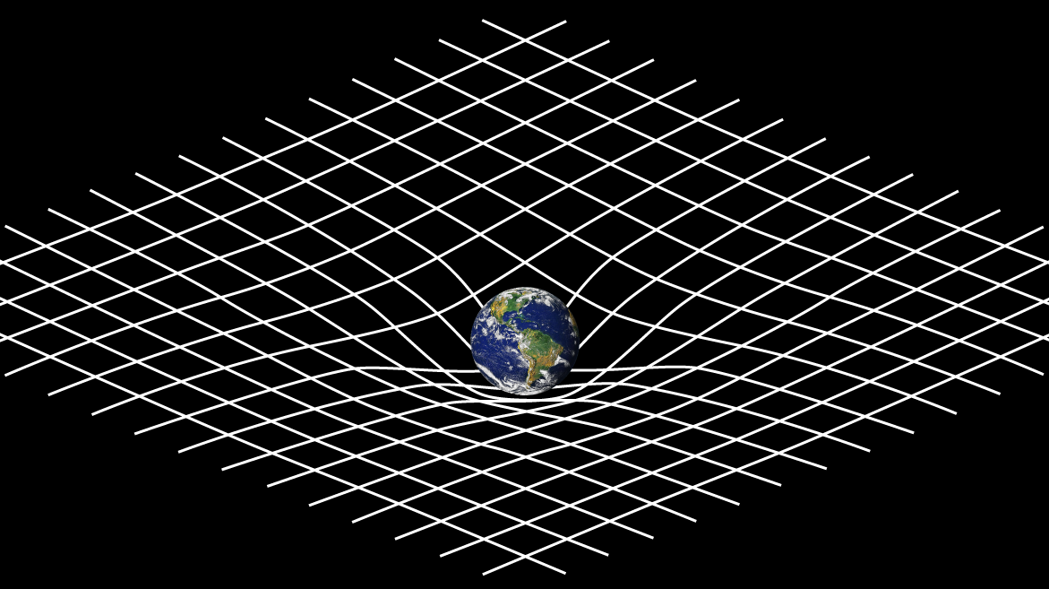
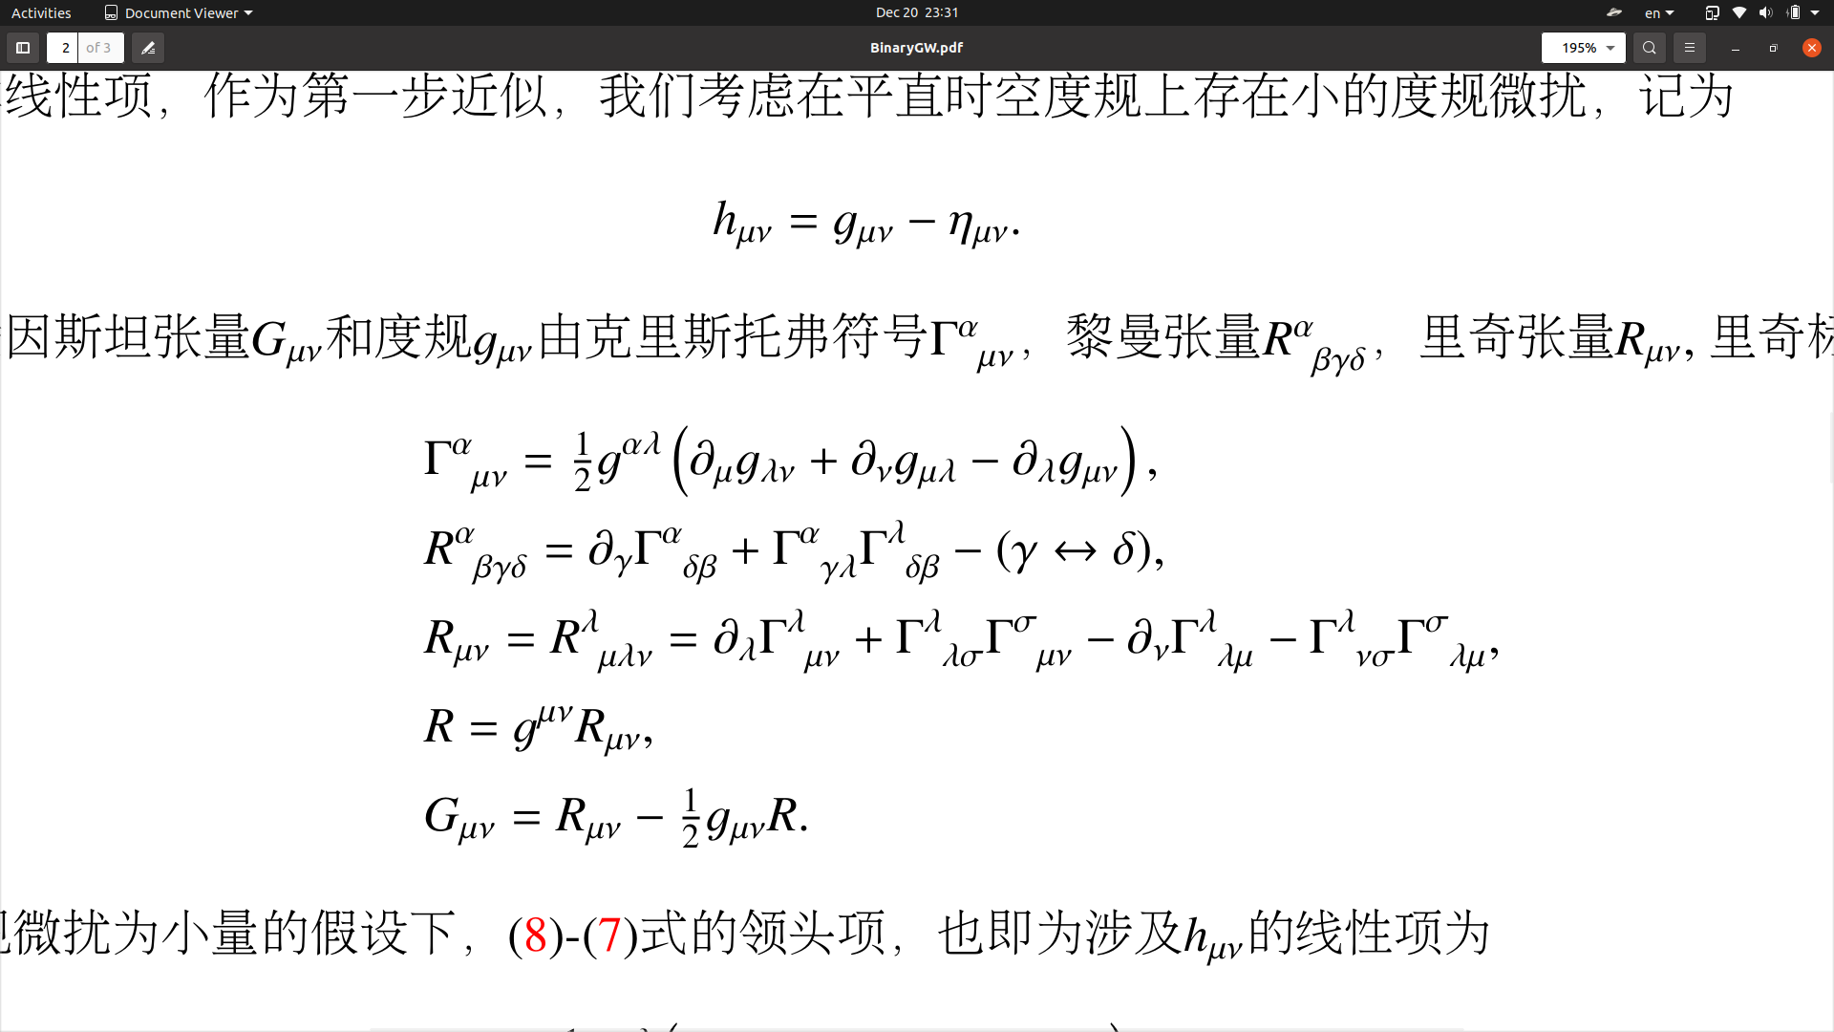
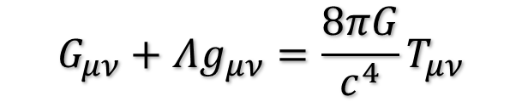
Friedmann equation in general relativity
$$G_{μν}+Λg_{μν}=\frac{8πG}{c^{4}}T_{μν}$$

Slide 8
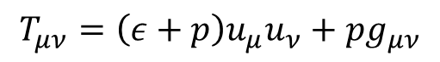
Friedmann equation in general relativity
$$T_{μν}=\left(ε+p\right)u_{μ}u_{ν}+pg_{μν}$$
$$G_{μν}+Λg_{μν}=\frac{8πG}{c^{4}}T_{μν}$$

Slide 9

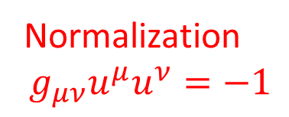
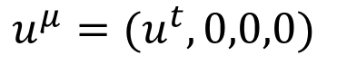
Friedmann equation in general relativity
$$T_{μν}=\left(ε+p\right)u_{μ}u_{ν}+pg_{μν}$$
$$G_{μν}+Λg_{μν}=\frac{8πG}{c^{4}}T_{μν}$$
isotropy
$$u^{μ}=(u^{t},0,0,0)$$
Normalization
$$g_{μν}u^{μ}u^{ν}=−1$$
$$u^{t}=1$$
The coarse-grained cosmic fluid’s proper time is the comoving time

Slide 10
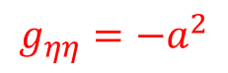
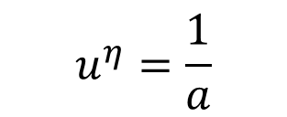
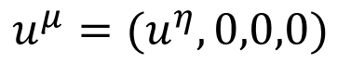
Friedmann equation in general relativity
$$T_{μν}=\left(ε+p\right)u_{μ}u_{ν}+pg_{μν}$$
$$G_{μν}+Λg_{μν}=\frac{8πG}{c^{4}}T_{μν}$$
isotropy
$$u^{μ}=(u^{η},0,0,0)$$
Normalization
$$g_{μν}u^{μ}u^{ν}=−1$$
$$u^{η}=\frac{1}{a}$$
$$g_{ηη}=−a^{2}$$

Slide 11
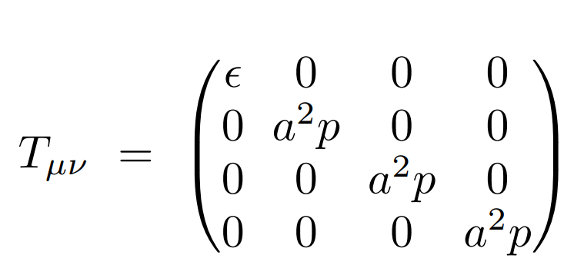
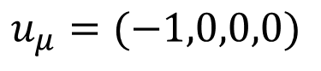
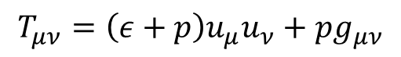
Friedmann equation in general relativity
$$T_{μν}=\left(ε+p\right)u_{μ}u_{ν}+pg_{μν}$$
$$G_{μν}+Λg_{μν}=\frac{8πG}{c^{4}}T_{μν}$$
$$u_{μ}=(−1,0,0,0)$$
isotropy
$$u^{μ}=(u^{t},0,0,0)$$
Normalization
$$g_{μν}u^{μ}u^{ν}=−1$$
$$u^{t}=1$$
The coarse-grained cosmic fluid’s proper time is the comoving time

Slide 12
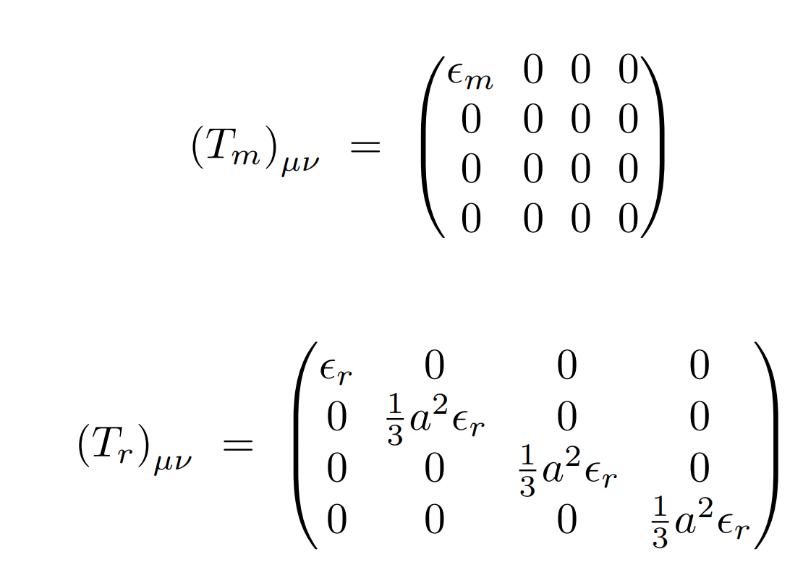
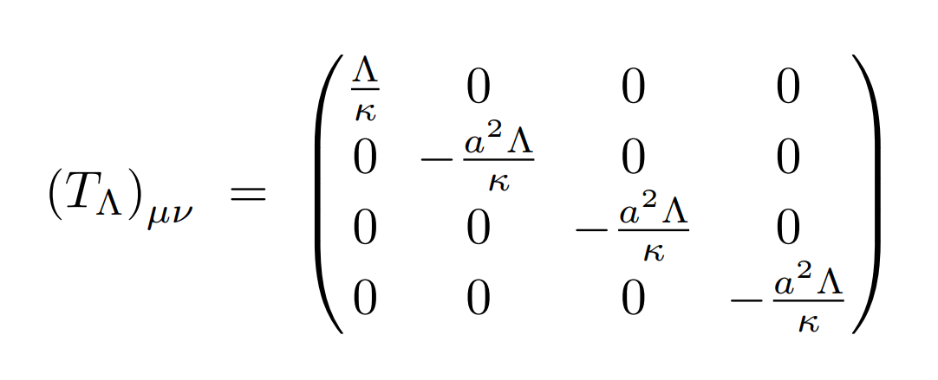
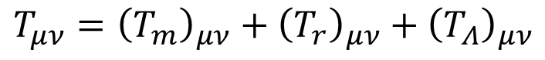
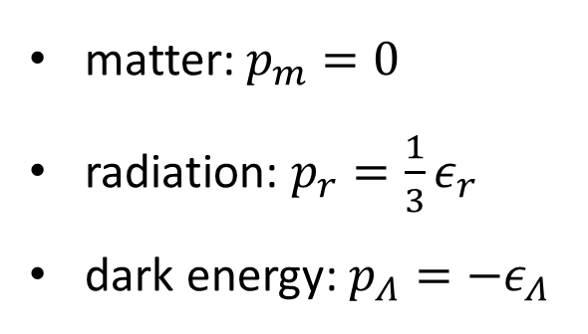
Friedmann equation in general relativity
$$G_{μν}+Λg_{μν}=\frac{8πG}{c^{4}}T_{μν}$$
matter: $p_{m}=0$
radiation: $p_{r}=\frac{1}{3}ε_{r}$
dark energy: $p_{Λ}=−ε_{Λ}$
$$T_{μν}={\left(T_{m}\right)}_{μν}+{\left(T_{r}\right)}_{μν}+{\left(T_{Λ}\right)}_{μν}$$

Slide 13
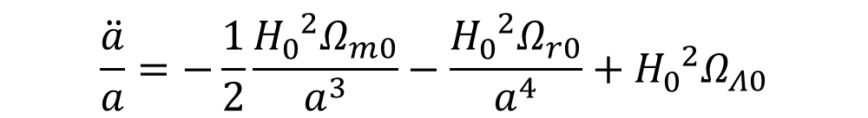
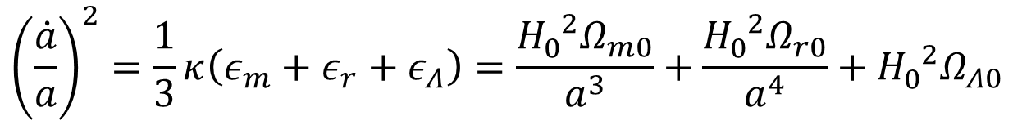
Friedmann equation with dark energy
$${\left(\frac{\dot{a}}{a}\right)}^{2}=\frac{1}{3}κ\left(ε_{m}+ε_{r}+ε_{Λ}\right)=\frac{H_{0}^{ 2}Ω_{m0}}{a^{3}}+\frac{H_{0}^{ 2}Ω_{r0}}{a^{4}}+H_{0}^{ 2}Ω_{Λ0}$$
$$\frac{\ddot{a}}{a}=−\frac{1}{2}\frac{H_{0}^{ 2}Ω_{m0}}{a^{3}}−\frac{H_{0}^{ 2}Ω_{r0}}{a^{4}}+H_{0}^{ 2}Ω_{Λ0}$$

Slide 14
Outline
Homogenous and isotropic cosmology
CMB anisotropy

Slide 15
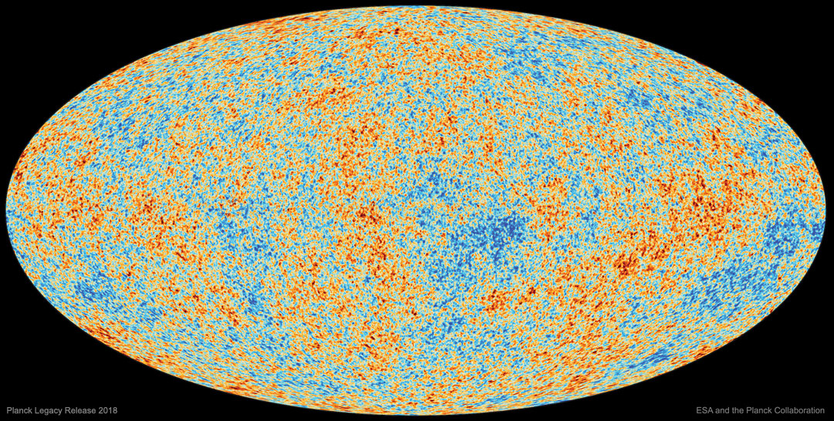
Inhomogeneity and anisotropy
Matter clustering: nonlinear simulation
CMB anisotropy: linear perturbation

Slide 16


CMB
Radiation component of the universe
Macroscopic description: fluid
$$G_{μν}=\frac{8πG}{c^{4}}\left[{\left(T_{m}\right)}_{μν}+{\left(T_{r}\right)}_{μν}+{\left(T_{Λ}\right)}_{μν}\right]$$
Energy-momentum conservation
$$D_{μ}\left[{\left(T_{m}\right)}^{μν}+{\left(T_{r}\right)}^{μν}\right]=0$$

Slide 17
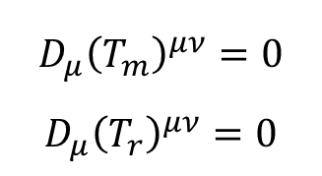
CMB
Radiation component of the universe
Macroscopic description: fluid
$$G_{μν}=\frac{8πG}{c^{4}}\left[{\left(T_{m}\right)}_{μν}+{\left(T_{r}\right)}_{μν}+{\left(T_{Λ}\right)}_{μν}\right]$$
Energy-momentum conservation
$$D_{μ}\left[{\left(T_{m}\right)}^{μν}+{\left(T_{r}\right)}^{μν}\right]=0$$
$$D_{μ}{\left(T_{m}\right)}^{μν}=0$$
$$D_{μ}{\left(T_{r}\right)}^{μν}=0$$
Only okay for isotropic universe

Slide 18
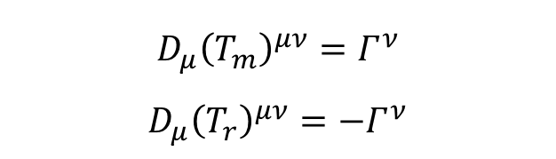
CMB
Radiation component of the universe
Macroscopic description: fluid
$$G_{μν}=\frac{8πG}{c^{4}}\left[{\left(T_{m}\right)}_{μν}+{\left(T_{r}\right)}_{μν}+{\left(T_{Λ}\right)}_{μν}\right]$$
Energy-momentum conservation
$$D_{μ}\left[{\left(T_{m}\right)}^{μν}+{\left(T_{r}\right)}^{μν}\right]=0$$
$$D_{μ}{\left(T_{m}\right)}^{μν}=Γ^{ν}$$
$$D_{μ}{\left(T_{r}\right)}^{μν}=−Γ^{ν}$$
interaction between matter and photon contributes to anisotropies in CMB

Slide 19
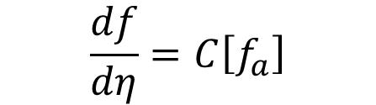
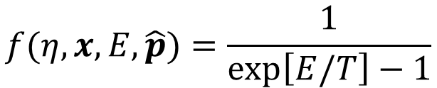
CMB
Microscopic description: Bose-Einstein system
Equation of motion: Boltzmann equation
$$f(η,x,E,\hat{p})=\frac{1}{exp\left[E/T\right]−1}$$
$$\frac{df}{dη}=C\left[f_{a}\right]$$
Interaction with other particles

Slide 20
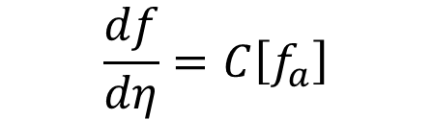
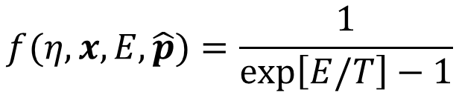
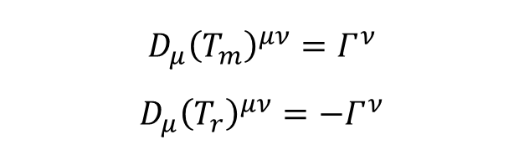
CMB
Statistic description: Bose-Einstein system
Equation of motion: Boltzmann equation
$$f(η,x,E,\hat{p})=\frac{1}{exp\left[E/T\right]−1}$$
$$D_{μ}{\left(T_{m}\right)}^{μν}=Γ^{ν}$$
$$D_{μ}{\left(T_{r}\right)}^{μν}=−Γ^{ν}$$
$$\frac{df}{dη}=C\left[f_{a}\right]$$
Interaction with other particles

Slide 21
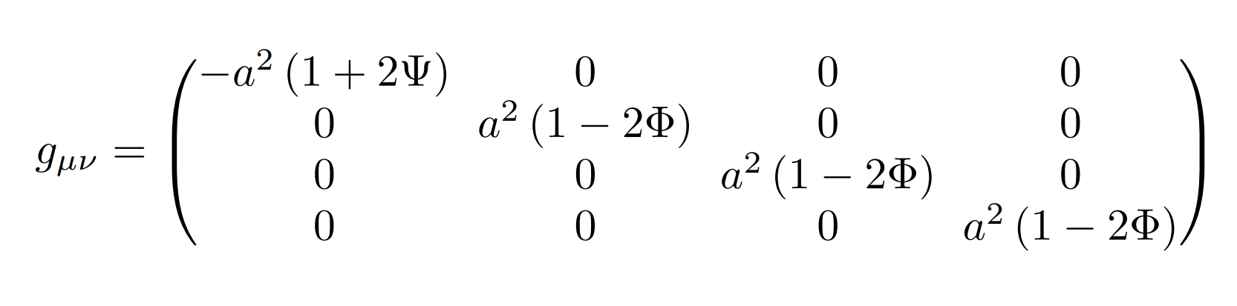
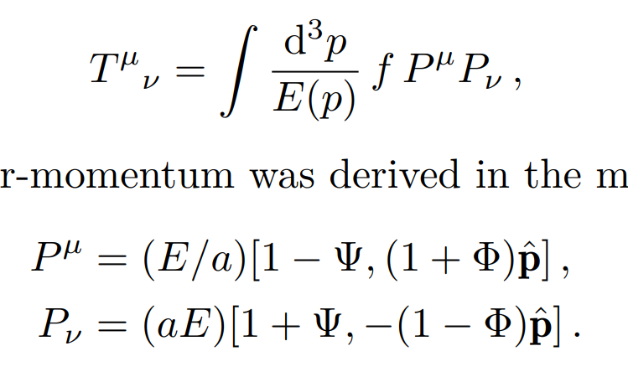
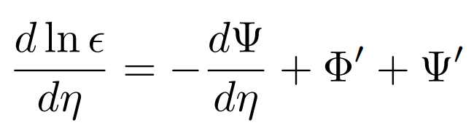
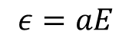
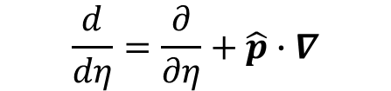

Boltzmann equation: 0th order
Prerequisites:
Photon 4-momentum in the perturbed FLRW spacetime
Photon geodesic in the perturbed FLRW spacetime
$$P^{μ}D_{μ}P^{ν}=0$$
$$\frac{d}{dη}=\frac{∂}{∂η}+\hat{p}∙∇$$
$$ε=aE$$

Slide 22


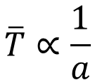

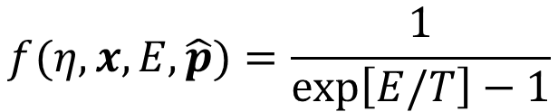
Boltzmann equation: 0th order
$$\frac{df}{dη}=0$$
$$f(η,x,E,\hat{p})=\frac{1}{exp\left[E/T\right]−1}$$
$$\frac{dlnε}{dη}=0$$
$$ε=aE$$
$$\overline{T}∝\frac{1}{a}$$

Slide 23
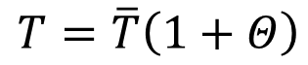
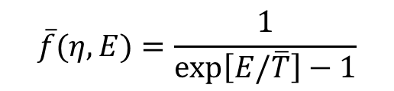
Boltzmann equation: 1st order
$$T=\overline{T}\left(1+Θ\right)$$
$$f\left(η,x,E,\hat{p}\right)=\frac{1}{exp\left[E/T\right]−1}=\overline{f}+{\overline{f}}^{2}\frac{E}{\overline{T}}\exp\left[\frac{E}{\overline{T}}\right]Θ\left(η,x,\hat{p}\right)+O(2)$$
$$\overline{f}(η,E)=\frac{1}{exp\left[E/\overline{T}\right]−1}$$
$E=E(η)$ as the photon propagates in the expanding universe
$$\frac{df}{dη}=\frac{d\overline{f}}{dη}+{\overline{f}}^{2}\frac{E}{\overline{T}}\exp\left[\frac{E}{\overline{T}}\right]\frac{dΘ}{dη}+O\left(2\right)=−{\overline{f}}^{2}\frac{E}{\overline{T}}\exp\left[\frac{E}{\overline{T}}\right]\left(\frac{dlnE}{dη}−\frac{dln\overline{T}}{dη}−\frac{dΘ}{dη}\right)+O\left(2\right)$$

Slide 24
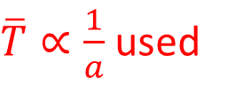
Boltzmann equation: 1st order
$$T=\overline{T}\left(1+Θ\right)$$
$$f\left(η,x,E,\hat{p}\right)=\frac{1}{exp\left[E/T\right]−1}=\overline{f}+{\overline{f}}^{2}\frac{E}{\overline{T}}\exp\left[\frac{E}{\overline{T}}\right]Θ\left(η,x,\hat{p}\right)+O(2)$$
$$\overline{f}(η,E)=\frac{1}{exp\left[E/\overline{T}\right]−1}$$
$E=E(η)$ as the photon propagates in the expanding universe
$\overline{T}∝\frac{1}{a}$ used
$$\frac{df}{dη}=−{\overline{f}}^{2}\frac{E}{\overline{T}}\exp\left[\frac{E}{\overline{T}}\right]\left(\frac{dln\left(aE\right)}{dη}−\frac{dΘ}{dη}\right)+O\left(2\right)=−{\overline{f}}^{2}\frac{E}{\overline{T}}\exp\left[\frac{E}{\overline{T}}\right]\left(\frac{dlnε}{dη}−\frac{dΘ}{dη}\right)+O\left(2\right)$$

Slide 25

Boltzmann equation: 1st order
$$\frac{df}{dη}=C\left[f_{a}\right]$$
$$LHS=\frac{df}{dη}=−{\overline{f}}^{2}\frac{E}{\overline{T}}\exp\left[\frac{E}{\overline{T}}\right]\left(\frac{dlnε}{dη}−\frac{dΘ}{dη}\right)+O\left(2\right)$$
$$RHS=C\left[f_{a}\right]=electron photon scattering=?$$

Slide 26
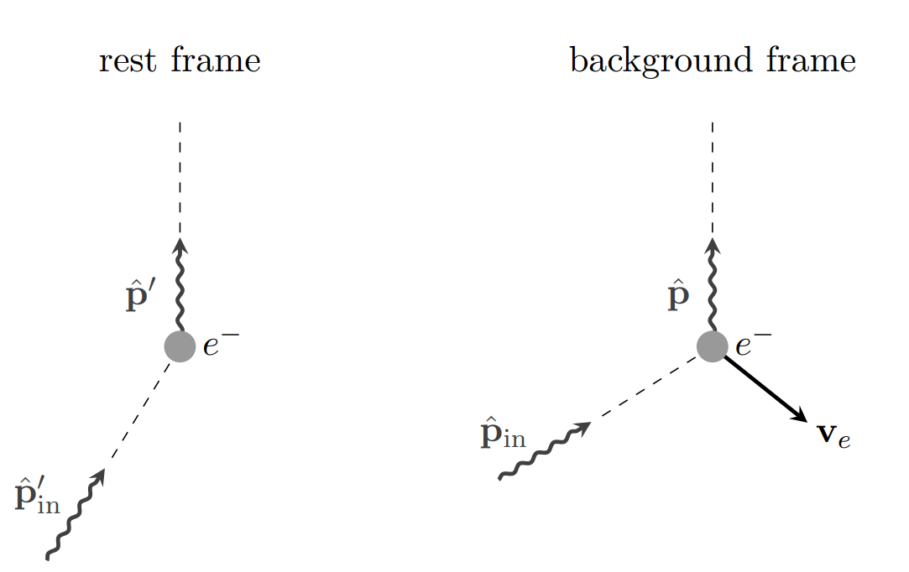
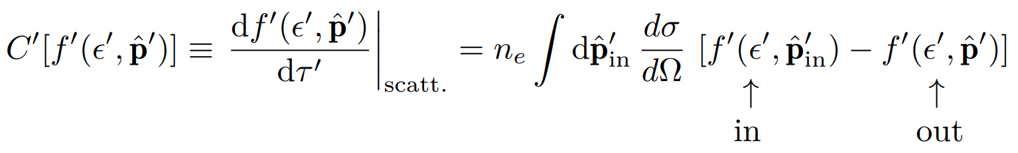
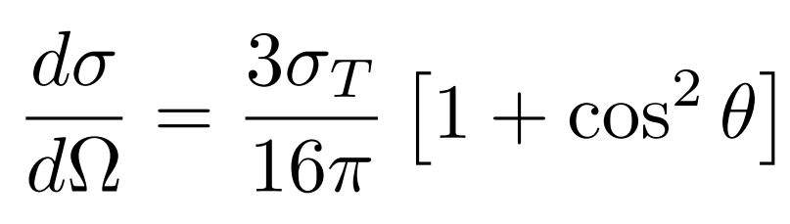
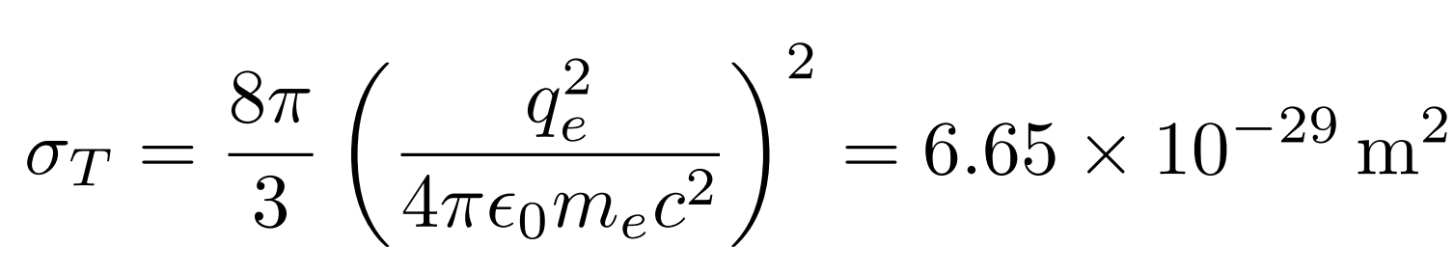
Electron-photon scattering: electron rest frame
Daniel Baumann, Cosmology, Cambridge University Press (2022)

Slide 27
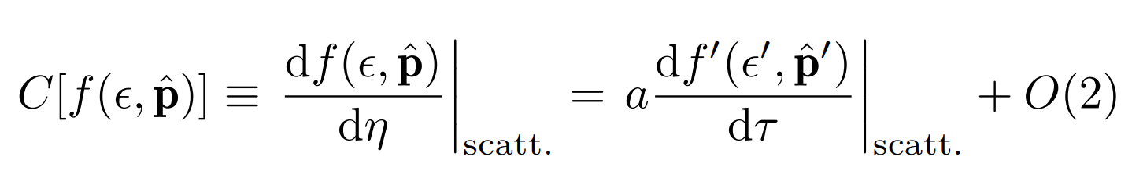
Electron-photon scattering: background frame
Daniel Baumann, Cosmology, Cambridge University Press (2022)

Slide 28
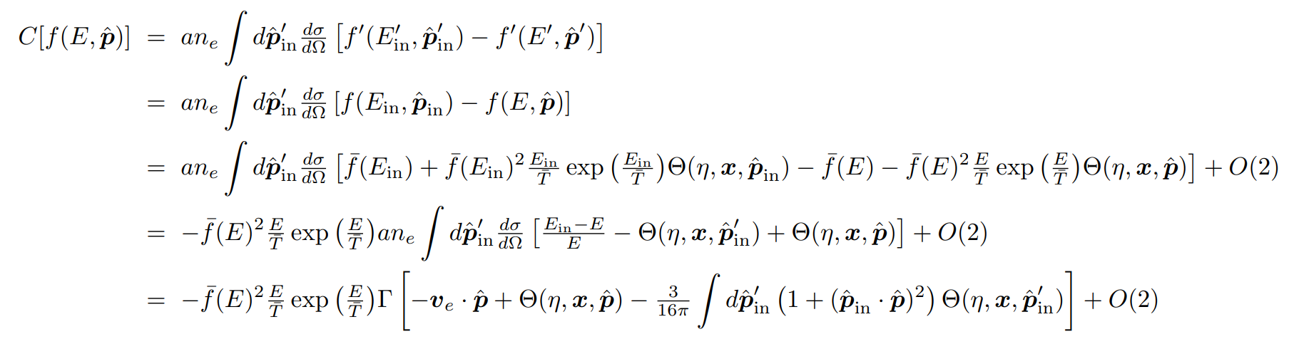
Electron-photon scattering: background frame
use

Slide 29

Boltzmann equation: 1st order
$$\frac{df}{dη}=C\left[f_{a}\right]$$
$$LHS=\frac{df}{dη}=−{\overline{f}}^{2}\frac{E}{\overline{T}}\exp\left[\frac{E}{\overline{T}}\right]\left(\frac{dlnε}{dη}−\frac{dΘ}{dη}\right)+O\left(2\right)$$
$$RHS=C\left[f_{a}\right]=−{\overline{f}}^{2}\frac{E}{\overline{T}}\exp\left[\frac{E}{\overline{T}}\right]×$$

Slide 30
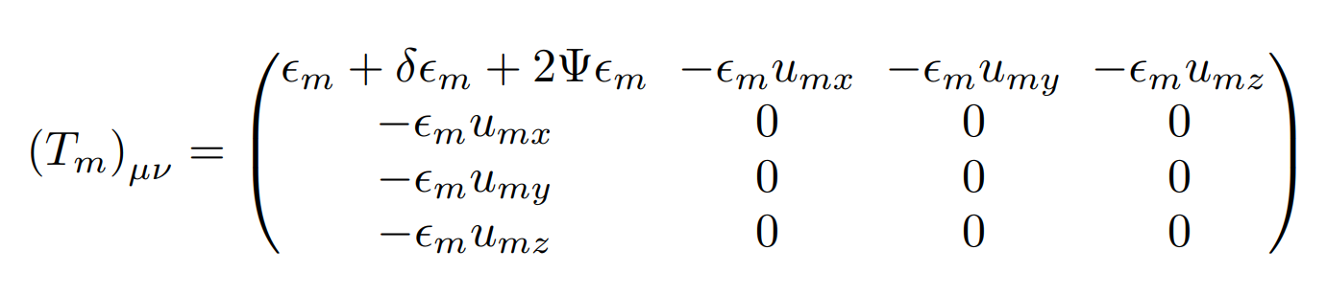

Relation between photon fluid variables and CMB temperature multipoles
Radiation component of the universe
Fluid description
$$G_{μν}=\frac{8πG}{c^{4}}\left[{\left(T_{m}\right)}_{μν}+{\left(T_{r}\right)}_{μν}+{\left(T_{Λ}\right)}_{μν}\right]$$

Slide 31


Relation between photon fluid variables and CMB temperature multipoles
Bose-Einstein distribution:
$$δε_{γ}=4ε_{γ}Θ_{0}$$
$$u_{γi}=−3ia{\hat{k}}^{i}Θ_{1}$$
$$Π_{ij}=−4a^{2}ε_{γ}({\hat{k}}^{i}{\hat{k}}^{j}−\frac{1}{3}δ_{ij})Θ_{2}$$

Slide 32
Summary
At the first order of perturbation, energy-momentum tensors of photon and baryon are not conserved separately due to the scattering between photon and electron
Conservation equations need to be replaced by Boltzmann equations

Slide 33






Summary
Fourier transformation
$$Θ→Θe^{ik∙x}$$
$$v_{e}=v_{b}=ikv_{b}$$
$$μ=\hat{k}∙\hat{p}$$

Slide 34

Summary (continue)

Slide 35


Summary of the perturbation equations

Slide 36


Initial condition
When $a→0$, $k≪\frac{a′}{a}$

Slide 37



CMB temperature spectrum
Observation:
Angular power spectrum

Slide 38


CMB temperature spectrum
Multipole moments of the temperature fluctuation
Theory:
Statistically isotropic initial conditions

